Slide 1
LECTURE: 6
Colonial Attacks on Language and Culture

Slide 2
OUTLINE: LECTURE 6
Colonial Attacks on Language and Culture
Learning Objectives:
Understand nationalism and its theoretical framework.
Know how Bengali nationalism emerged among the people of East Pakistan.
Explain repressive treatment of West Pakistan over Bengali language.
Get how cultural frontier played pivotal role in creating a political platform for Bengalis.
Identify how Language Movement united the people of East Pakistan against the misrule of Muslim League.

Slide 3
BENGALI NATIONALISM
Emergence of Bengali Nationalism:
The question on Identity and Language ?
What started as part of the Pakistani nationalist project ended up as the beginning of a new wave, Bengali nationalism.

Slide 4
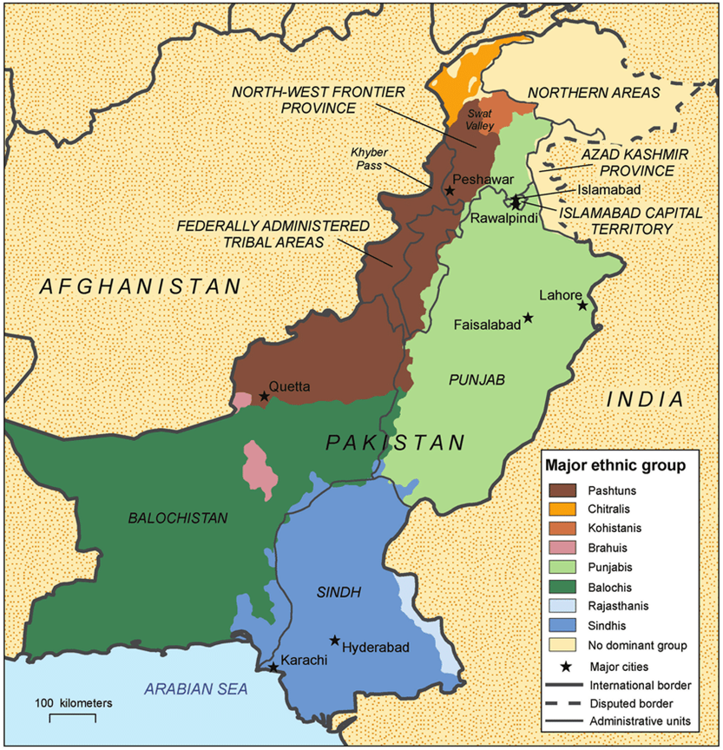
DISSIMILARITIES BETWEEN TWO WINGS
Factors of difference
Ethnic build-up
Language
Tradition
Culture
Social behavior pattern
Economic activity

Slide 5
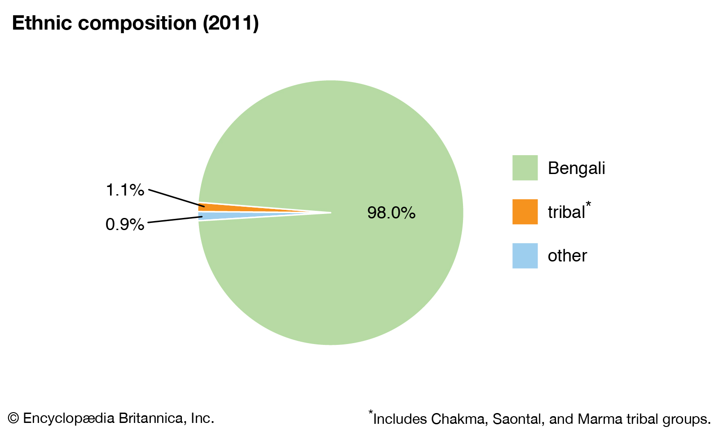
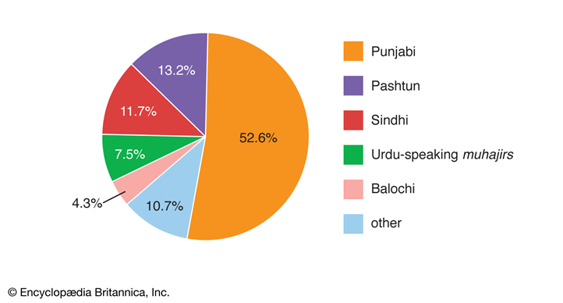
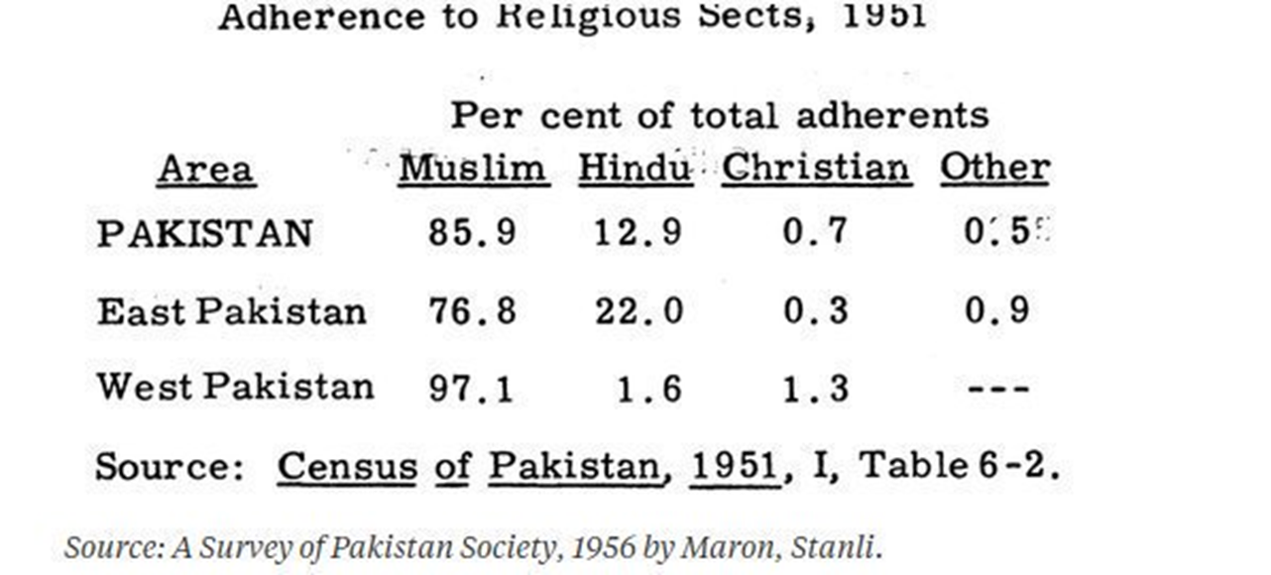
ETHNIC COMPOSITION OF LANGUAGE IN PAKISTAN
Ethnic composition in East Pakistan
Ethnic composition in West Pakistan

Slide 6
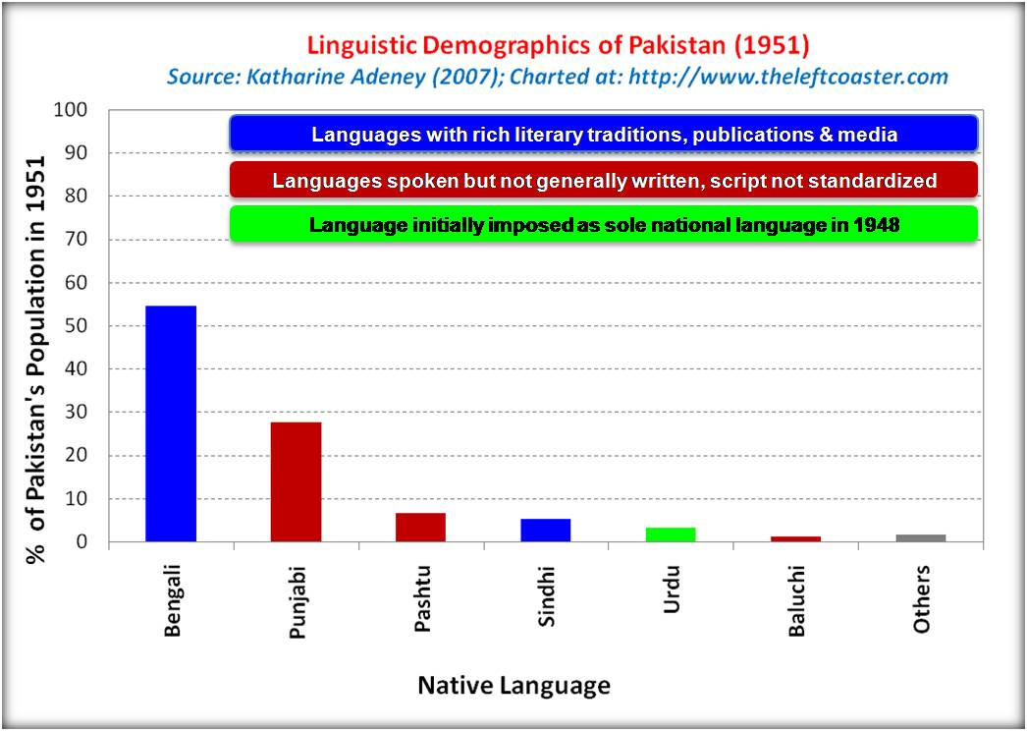
URDU AS A STATE LANGUAGE
URDU was the language of the ‘Ashraf’ class
Urdu was spoken by 3% of the population
Bangla was spoken by more than 50% of the population of Pakistan
Bangla was rich in literature

Slide 7
INITIAL STAGE OF LANGUAGE MOVEMENT
Issue of language was raised immediately after the creation of Pakistan
Attempt from West Pakistani leaders to create a lingua franca (a common language) as the state language
Prof. Ziauddin Ahmed proposed Urdu as the state language of Pakistan
Language was considered as political tool to solidify unity between East and West Pakistan
Number of youth organizations were formed in East Pakistan (Gono Azadi League, Democratic Youth League, TAMADDUN MAJLISH, East Pakistan Youth League)

Slide 8
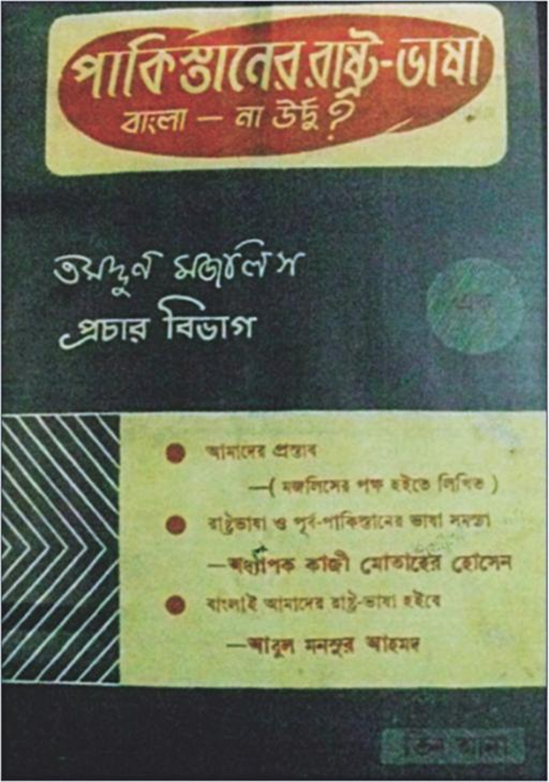
TAMADDUN MAJLISH
Tamaddun Majlish played the pioneering role to protest against the attempt of making Urdu as the only state language of Pakistan.
Tamaddun Majlish issued a pamphlet on 15 September 1947 titled Pakistaner Rashtra Bhasha: Bangla na Urdu (Pakistan's State Language: Bangla or Urdu) edited by Professor Abul Quasem.
Tamaddun Majlish took initatives to form the first Rastrabhasa Sangram Parisad (State Language Committee of Action) on 1 October 1947.

Slide 9
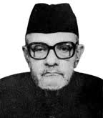
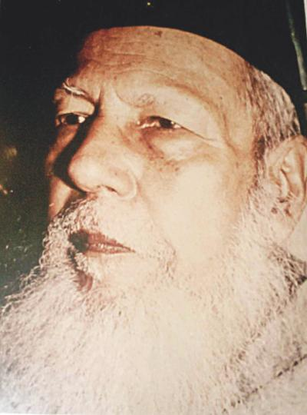
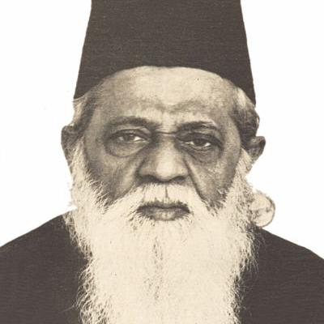
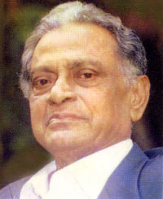
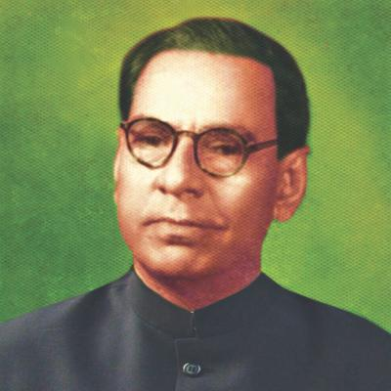
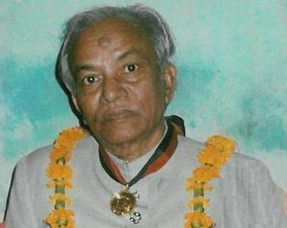
TAMADDUN MAJLISH
Dewan Mohammad Azraf
Kaji Motahar Hossain
Dr. Muhammad Shahidullah
Kazi Golam Mahbub
Abul Mansur Ahmad
Principal Abul Kashem
Some leaders and activists of Tamaddun Majlish

Slide 10
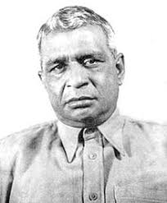
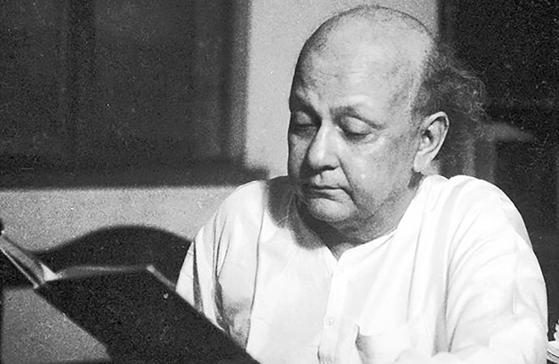
On Lingua Franca
In the Pakistan Constituent Assembly in 1948, Dhirendranath Datta demanded the use of Bangla along with English and Urdu for conducting Assembly proceedings.
Syed Mujtaba Ali wrote “Purba Pakistan er Rastrobhasha” in 1949 where he predicted Bengali will never accept Urdu and it will eventually lead to separation.

Slide 11
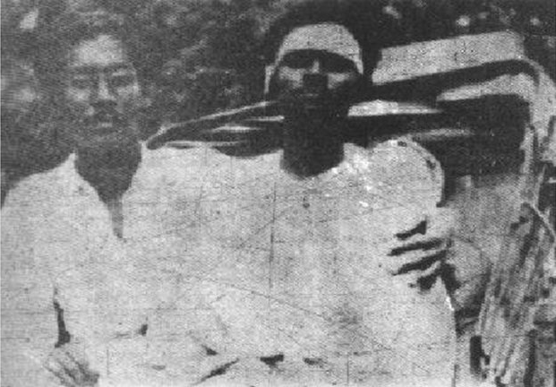
STUDENTS IN MOVEMENT
State Language Committee of Action (SLCA) was formed consisting to representatives from the organizations below: Gono Azadi League, Democratic Youth League, Tamaddun Majlis, Salimullah Muslim Hall, Fazlul Haque Muslim Hall, Other Dhaka University Halls and East Pakistan Muslim Students League
SLCA along with other organizations later evolved to All Party State Language Committee (1948)
Number of strikes were held from february till early March
Sheikh Mujib taking his fellow compatriot Shawkat Ali to the hospital, who was injured by a police attack in front of the secretariat during a demonstration demanding Bangla as one of the State languages of Pakistan, on March 11, 1948. Later on Arrested.
Photo: 100 Years of Mujib Photo Archive

Slide 12
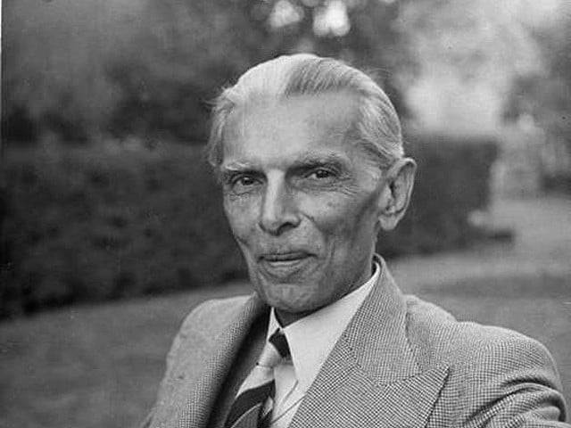
STUDENTS IN MOVEMENT
Bengali Newspapers were banned
A conferences took place between the SLCA and Khwaja Nazimuddin regarding negotiation over state language and Nazimuddin accepted 8 points by the SLCA
Some of Youth Representatives were released from jail
Jinnah Arrived in Dhaha 19th March 1948
Jinnah Declared Urdu as the only language and Nazim Uddin’s deal was void
Students protested immediately after Jinnah’s speech

Slide 13
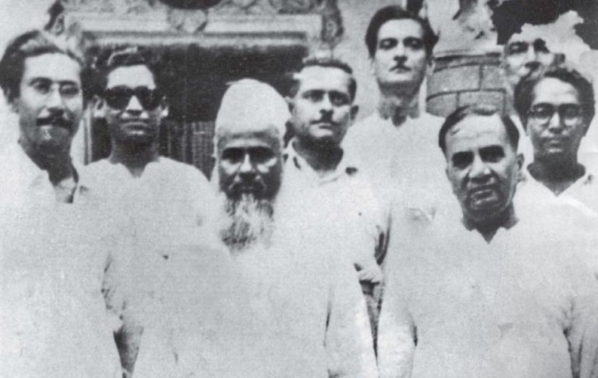
EAST PAKISTAN AWAMI MUSLIM LEAGUE
From the left Sheikh Mujib, Maulana Abdul Hamid khan Bhashani, Huseyn Shaheed Suhrawardy (1949)
The Awami Muslim League was founded in Rose Garden of KM Das Lane, Dhaka on 23 June 1949
Maulana Abdul Hamid khan Bhashani was the president of the Awami League

Slide 14
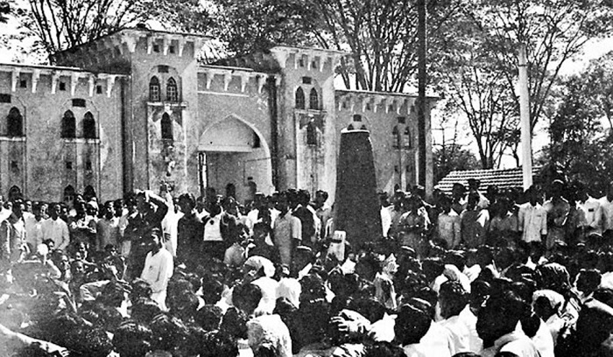
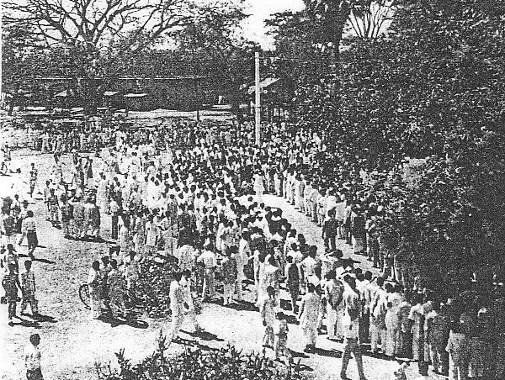
21 FEBRUARY, 1952
The historic gathering of students in front of Dhaka Medical College entrance and Language Martyrs
The Dhaka University State Language Committee of Action took the initiative to violate the 144 CrPc. Oli Ahad, Abdul Matin, Shamsul Alam, Dr Golam Mawla voted to violate the 144 CrPc.

Slide 15
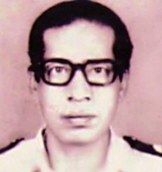

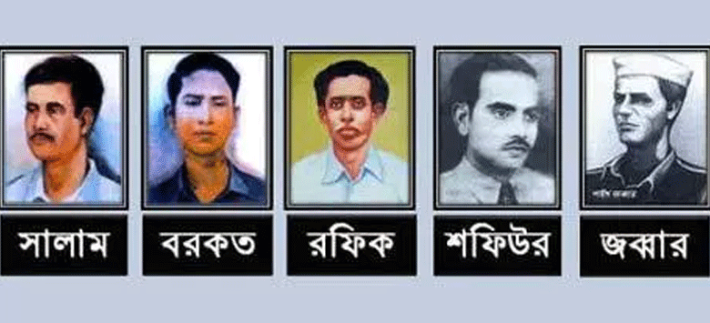
21 FEBRUARY, 1952
Police Fired at the protestors where a student and an unknown boy on the roadside died immediately. Later on till 22nd february total number of confirmed martyrs were 8.
Police removed the bodies on the night of 21st to the Azimpur graveyard secretly.
Abdul Awal
Mohammad Ohiullah

Slide 16
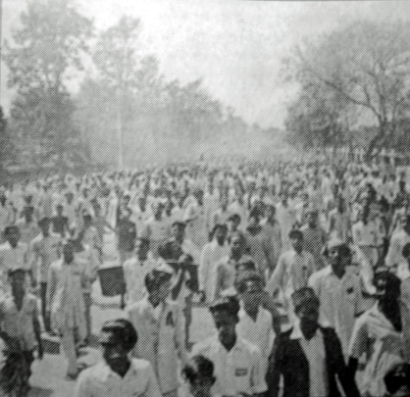
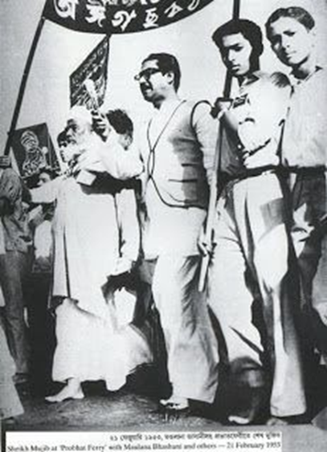
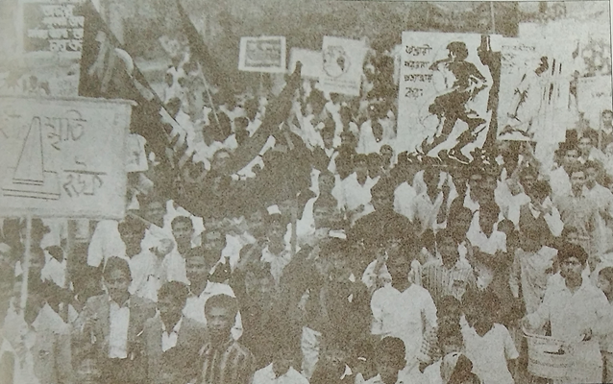
STUDENTS IN MOVEMENT
A NATIONWIDE MOVEMENT
The reaction to the police killings in students’ procession was immediate.
All over the country, schools and colleges held protest meetings, rallies and processions. on 22-23rd February
22 February rally after janaza at Dhaka Medical College
Students of Dhaka Fine Arts Institute brings out a rally on 21 February 1953

Slide 17
ATTACK ON CULTURE CONTINUES
Demand for status of state language for Bangla continues
Though Bangla was considered as a state language in 1956 constitution the assault on Bengali culture continued.
During Ayub era the idea of writing Bangla in Roman script was propagated.
Considering the poems and songs of RabindranathTagore as against values of Pakistan state government stopped broadcasting those in Radio Pakistan in 1967.
Bangla New Year Celebration, Pahela Baishak was considered as a festival of the minorities, the Hindu community.

Slide 18
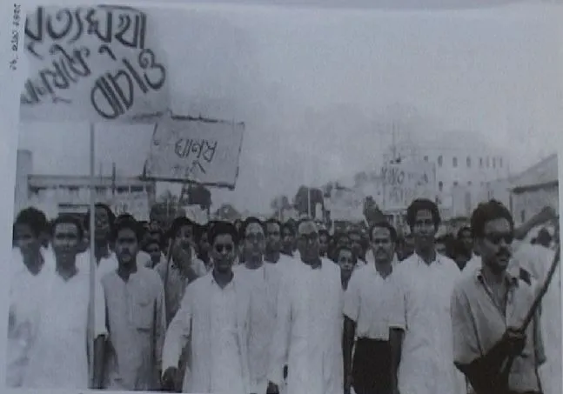
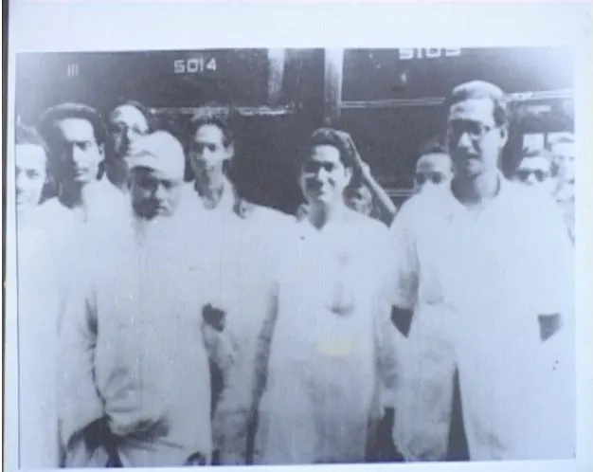
Pictures 1948-1956
১৯৫৬ সালে সেই সময়ের আবু হোসেন সরকারের বিরুদ্ধে ভূখা মিছিল, সামনের সারিতে বাম দিক থেকে তাজউদ্দিন আহমদ, মাঝখানে কালো চশমা পরিহিত অলি আহাদ, ইয়ার মোহাম্মদ খান, জহিরুদ্দিন আহমদ, আতাউর রহমান খান, মহিউদ্দিন আহমদ ও মন্টু খান
১৯৫৫ সালে ফুলবাড়ীয়া রেল স্টেশনে মাওলানা আব্দুল হামিদ খাঁন ভাসানী, অলি আহাদ, শেখ মুজিবুর রহমান

Slide 19
Suggested Readings
The Emergence of Bangladesh
Volume I
(1947-1958)
by Badruddin Umar
Chapter: 5,20,21
Link to Timelines:
https://www.timetoast.com/timelines/time-line-a-brief-history-of-the-bangla-language-movement-2671e6a4-e08f-4710-aa7d-6348ac63dd3c

